Slide 1

Enterprise Design Patterns
Dima Ionut Daniel

Slide 2
Contents
What are Design Patterns ?
What is Java EE ?
Java EE History
Java EE Architecture
Domain Driven Design
Continuos Delivery
Software Design
Microservices Design
Conclussion
Bibliography

Slide 3

What are Design Patterns ?
A software design pattern is a general reusable solution to a commonly occurring problem within a given context in software design.
Design patterns are formalized best practices that the programmer can use to solve common problems when designing an application or system.
Design patterns may be viewed as a structured approach to computer programming intermediate between the levels of a programming paradigm and a concrete algorithm.

Slide 4
What is Java EE ?
Java Platform, Enterprise Edition or Java EE is Oracle's enterprise Java computing platform.
Java EE extends the Java Platform, Standard Edition providing an API for object-relational mapping, distributed and multi-tier architectures, and web services.
Java EE is defined by its specification.

Slide 5
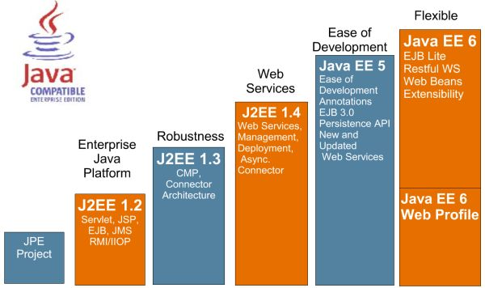
Java EE History

Slide 6
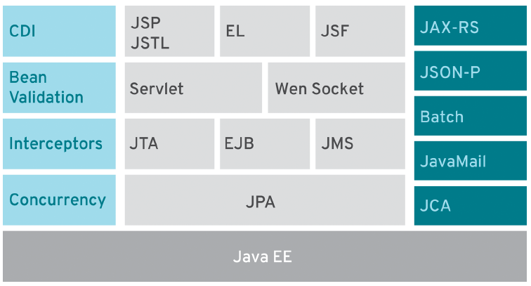
Java EE Architecture
Java EE 7 architecture.

Slide 7
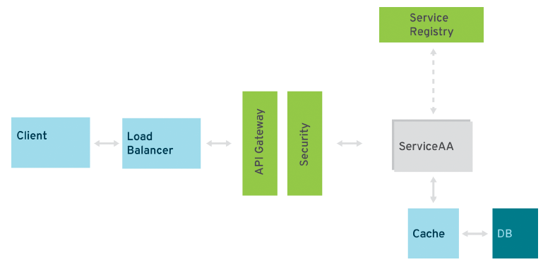
Java EE Architecture (cont.)
In order to build a complete and reliable microservices application we need something more.

Slide 8
Domain Driven Design
Domain-driven design (DDD) is all about focusing on the complexity of the core business domain.
It aims to create models of a problem domain and the implementation details comes later.
It defines a set of concepts that are selected to be implemented in software.

Slide 9
Domain Driven Design (cont.)
Working with a model always happens within a context.
In DDD, this is called the bounded context (BC).
Every domain model lives in one BC, and a BC contains one domain model.
A BC helps to model and define interactions between the BC and the model.

Slide 10
Domain Driven Design (cont.)
Concepts of the model include:
Context
The setting in which a word or statement appears that determines its meaning;
Domain
A sphere of knowledge, influence, or activity. The subject area to which the user applies a program is the domain of the software;
Model
A system of abstractions that describes selected aspects of a domain and can be used to solve problems related to that domain;
Ubiquitous Language
A language structured around the domain model and used by all team members to connect all the activities of the team with the software.

Slide 11
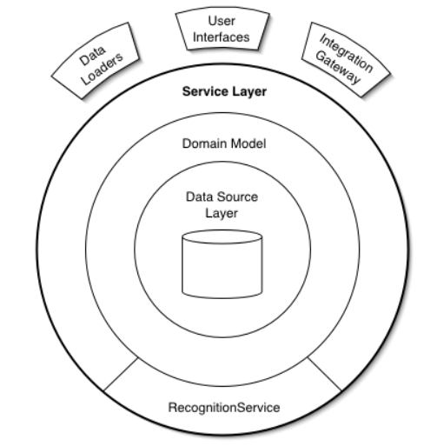
Domain Driven Design (cont.)
Service Layer defines an application's boundary with a layer of services that establishes a set of available operations and coordinates the application's response in each operation.

Slide 12
Domain Driven Design (cont.)
Process services follow the business services definition and are responsible for performing a single, complex task.
They represent a business action or process related to and relying on one or more core services.

Slide 13
Domain Driven Design (cont.)
Transaction services organizes business logic by procedures where each procedure handles a single request from the presentation.
A transaction may view some information as organized in a particular way, another will make changes to it.

Slide 14
Continuos Delivery
Continuous delivery (CD) is a software engineering approach in which teams produce software in short cycles, ensuring that the software can be reliably released at any time.
It aims at building, testing, and releasing software faster and more frequently.
The approach helps reduce the cost, time, and risk of delivering changes by allowing for more incremental updates to applications in production.

Slide 15
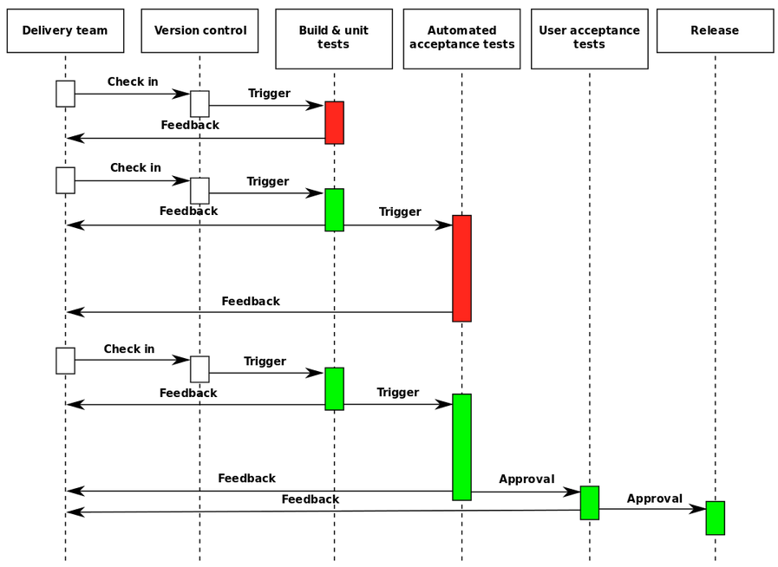
Continuos Delivery (cont.)

Slide 16
Software Design
Software design is the process by which an agent creates a specification of a software artifact, intended to accomplish goals, using a set of primitive components and subject to constraints.
Software design usually involves problem solving and planning a software solution.
It includes both a low-level component and algorithm design and a high-level, architecture design.

Slide 17
Software Design (cont.)
Design for Failure
With applications composed of a large number of individual services we need to measure availability and design for failure.
The goal of the design around failure tolerance is to minimize human intervention.
Implementing automatic failure routines has to be part of every service call that is happening.

Slide 18
Software Design (cont.)
Service load balancing and automatic scaling
Every microservice needs a defined set of metadata that allows you to find out more information about utilization and average response times.
Depending on thresholds, services should be scaled automatically, either horizontally (add more physical machines) or vertically (add more running software instances to one machine).

Slide 19
Software Design (cont.)
To mark services as failing, we need to keep track of invocation numbers and implement a way to retry a reasonable number of times until we decide to completely dismiss a service instance for future calls.
There are 4 patterns that will help you to implement the desired behavior of services:
Retry on failure
Circuit Breaker
Bulkheads
Timeouts

Slide 20
Software Design (cont.)
Retry on failure
This pattern enables the application to handle anticipated, temporary failures when it attempts to connect to a service by transparently retrying an operation that has previously failed in the expectation that the cause of the failure is transient.
We can implement a retry pattern with/without dynamic and configurable number of retries based on service metadata.
The retries can be implemented sync, blocking or async nonblocking.

Slide 21
Software Design (cont.)
Circuit Breaker
The circuit breaker handles faults that may take a variable time to connect to a remote service.
It acts as a proxy for operations that are at risk to fail.
The proxy monitors the number of recent failures, and then uses this information to decide whether to allow the operation to proceed or simply return an exception immediately.

Slide 22
Software Design (cont.)
Bulkheads
The name stands for partitioning your system and making it failureproof.
If it's done correctly, we can confine errors to one area as opposed to taking the entire system down.
Timeouts
Unlike endlessly waiting for a resource to serve a request, a dedicated timeout leads to signaling a failure early.
This is a simple form of the retry or circuit breaker and may be used in situations when talking to more low-level services.

Slide 23
Software Design (cont.)
Design for Integrity
While data for each service is kept fully separate, services can be kept in a consistent state with compensating transactions.
It's recommended to use transactions(atomic or extended).
If transactions are not suitable we might want to reduce the complexity by separating read-only services from write-only services.

Slide 24
Software Design (cont.)
Event-driven design is another approach to transactions.
By registering and consuming the events, services can react to the ordered stream of events.
The consuming services must be responsible and able to read the events at their own speed and availability.

Slide 25
Software Design (cont.)
By using transactions IDS into the payload, the subsequent service calls are able to identify long-running transactional requests.
Until all services successfully pass all contained transactions, the data modification is only flagged.
Preceding solutions lead to different levels of consistency and there might be even more ways of working around two phase-commit/XA (eXtended Architecture) transactions

Slide 26
Software Design (cont.)
Design for Performance
Performance is the most critical part of all enterprise applications.
This nonfunctional requirement of all, it's still the most complained about.
Microservices-based architectures can significantly impact performance in both directions.

Slide 27
Software Design (cont.)
Load-test early, load-test often
Performance testing is an essential part of distributed applications.
We need to make sure that the performance of the complete system and individual services are actively tested.
This is equally important as actual runtime monitoring.

Slide 28
Software Design (cont.)
The usual approach is to base all your endpoints on RESTful calls
Some services will be better off communicating via synchronous or asynchronous messaging.
Another important aspect is API versioning and management.
Using an API we can keep track of various aspects of the interfaces.
This will allow to dispatch based on service versions, and most of them offer load balancing features.
It's important to keep track of the individual number of calls per service and version.

Slide 29
Software Design (cont.)
Caching has an impact in performance, mostly in microservices architectures.
There are 2 types of data in applications: the type that can be heavily cached, and the type that should never be cached.
The easiest case is to use a cache is to use dedicated in-memory datastore as a caching layer for domain entities.

Slide 30
Software Design (cont.)
Service isolation
Services needs to be independently deployable.
If every service ideally comes with its own runtime, there is no chance a memory leak in one service can affect other services.

Slide 31
Software Design (cont.)
Security in microservices applications breaks down into 3 different levels
Application Level Security: authentication
User Level Security: authorization
Network Level Security: ports, OS, protocols, etc.

Slide 32
Software Design (cont.)
Application-level security
The application needs to have a login service that a user has to access.
Bases on the implementation of the service (username/password, client certification) a "credential" has to be generated that will be used to all involved components in the user's session.
The described mechanism is well known and works perfectly fine in monolithic applications.

Slide 33
Software Design (cont.)
This is completely different in a heavily distributed application that is composed of individual services, eventually running on different containers and implemented in different programming languages.
Possible solutions range from custom tokens that get passed on with every request to developing industry standards like OAuth2 to infrastructure-based enterprise access management (EAM) solutions.
A distributed identity needs to be made available to all services.

Slide 34
Software Design (cont.)
User Level Security
It maps the credentials or token in a downstream service to a user and check service-specific roles.
Gathering the required information with every service invocation will add additional loading times to every service because security information can’t be cached.
Finding the correct approach is highly specific to the business requirement of the individual services and depends on a number of factors.

Slide 35
Software Design (cont.)
Network Level Security
It's the most important layer in enterprise applications.
With penetration tests and other related security scans of applications, we have to implement a solution that doesn’t allow malicious requests to even reach your service endpoints without prior accreditation.

Slide 36
Software Design (cont.)
Logging
Because one service request can be split out to many different subsequent requests and produce an error somewhere downstream, logging should be able produce important information about what happened.
This can be done with request IDs, http session or even SSL session ID.

Slide 37
Software Design (cont.)
Health Checks
Every service needs to be monitored from the very beginning.
A simple approach is to select an API management solution that handles governance, load balancing, SLA and implicit health monitoring of every service.

Slide 38
Microservices Design
Use separate build for each microservice.
Use the logic in the services stateless.
Needing to replicate state across various services is a strong indicator of a bad design.
In order to keep service response times to a minimum, we should consider data caching in every service you build.

Slide 39
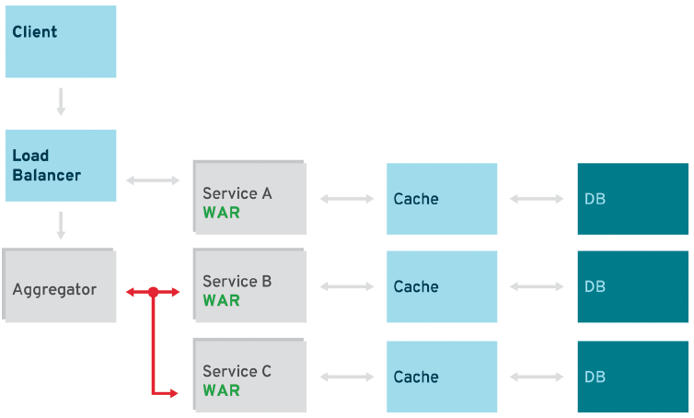
Microservices Design (cont.)
Aggregator Pattern
The primary goal of this pattern is to act as a special filter that receives a stream of responses from service calls and identifies or recognizes the responses that are correlated.
Once all the responses have been collected, the aggregator correlates them and publishes a single response to the client for further processing.

Slide 40
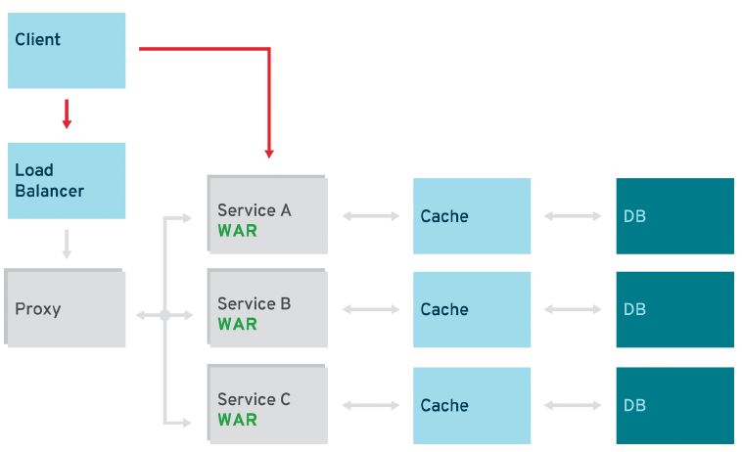
Microservices Design (cont.)
Proxy Pattern
The proxy pattern allows you to provide additional interfaces to services by creating a wrapper service as the proxy.
The wrapper service can add additional functionality to the service of interest without changing its code.

Slide 41
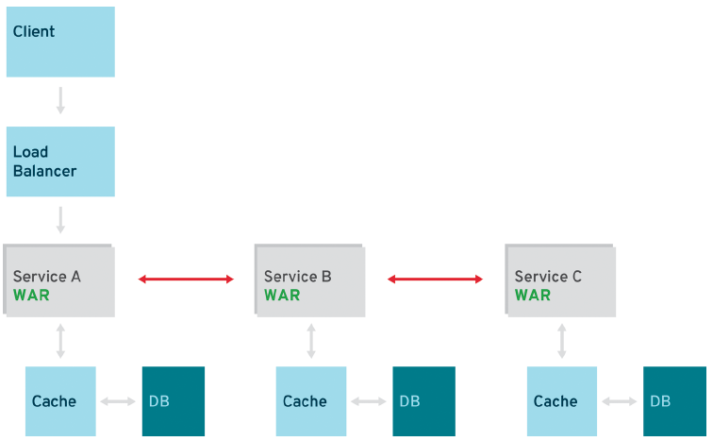
Microservices Design (cont.)
Pipeline Pattern
In certain flows, a single request triggers multiple steps to be executed.
The number of services that have to be called for a single response is larger than one.
A pipeline can be triggered synchronously or asynchronously, although the processing steps are most likely synchronous and rely on each other.
Chains shouldn’t exceed a certain amount of time if called synchronously.

Slide 42
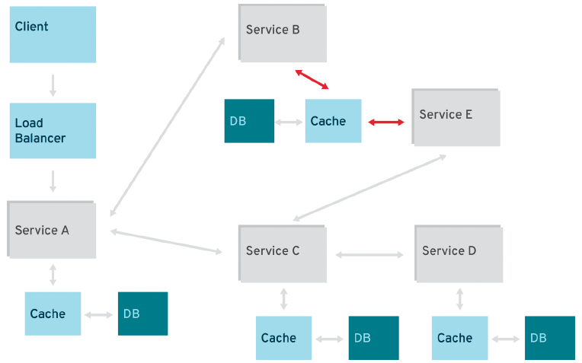
Microservices Design (cont.)
Shared Resources
A critical design principle of microservices is autonomy.
In migration scenarios it might be hard to correct design mistakes made a couple of years ago.
Running into a situation where microservices have to share a common data source isn’t ideal.

Slide 43
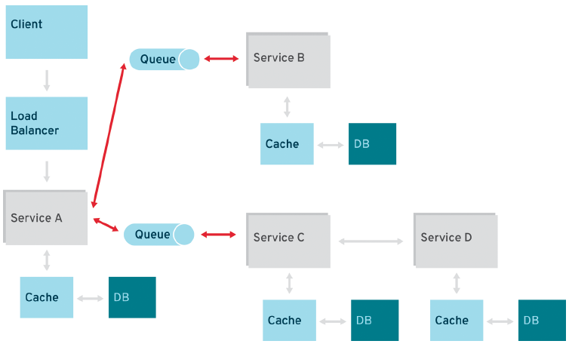
Microservices Design (cont.)
Asynchronous Messaging
RESTful design patterns are common in the microservices world.
Message-oriented middleware (MOM) is a more reasonable solution to integration and messaging problems.
A combination of REST request/response and pub/sub messaging may be used to accomplish the business need.

Slide 44
Conclussion
Patterns offers a reusable solution for a particular problem.

Slide 45

Bibliography
https://en.wikipedia.org/wiki/Domain-driven_design
https://en.wikipedia.org/wiki/Software_design
https://en.wikipedia.org/wiki/Continuous_delivery
O'Reilly - Modern JavaEE Design Patterns

Slide 46
Questions ?

